Slide 1


Ragan: Economics
Sixteenth Canadian Edition
Chapter 2
Economic Theories, Data, and Graphs
Copyright © 2020 Pearson Canada Inc.
Notes:
If this PowerPoint presentation contains mathematical equations, you may need to check that your computer has the following installed:
1) Math Type Plugin
2) Math Player (free versions available)
3) NVDA Reader (free versions available)

Slide 2
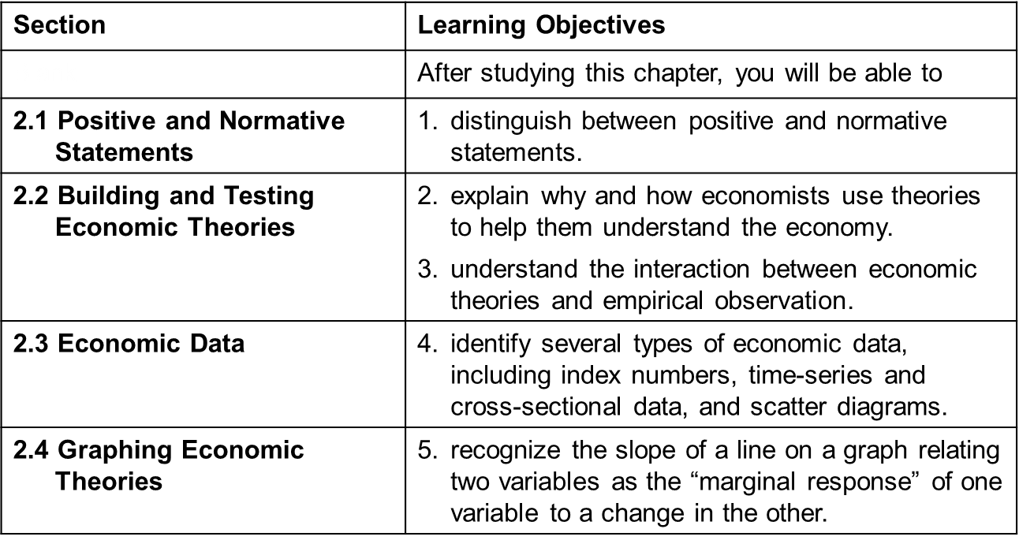
Chapter Outline/Learning Objectives

Slide 3
2.1 Positive and Normative Statements
Normative statements depend on value judgements and cannot be evaluated solely by a recourse to facts.
A normative statement is about what ought to be.
Positive statements do not involve value judgments. They are statements about matters of fact.
A positive statement is about what actually is, was, or will be.

Slide 4
Disagreements Among Economists
Economists often disagree with each other in public discussions
Many public disagreements are based on the positive/normative distinction.
A responsible economist states clearly which part of proffered advice is normative and what part is positive.
APPLYING ECONOMIC CONCEPTS 2-1
Where Economists Work

Slide 5
2.2 Building and Testing Economic Theories
What Are Theories?
A theory is an abstraction from reality.
A theory consists of:
variables
assumptions
predictions

Slide 6
Testing Theories (1 of 2)
A theory is tested by confronting its predictions with evidence.
If a theory is in conflict with facts, it will usually be amended to make it consistent with those facts, or it will be discarded to be replaced by a superior theory.
The scientific approach is central to the study of economics.

Slide 7
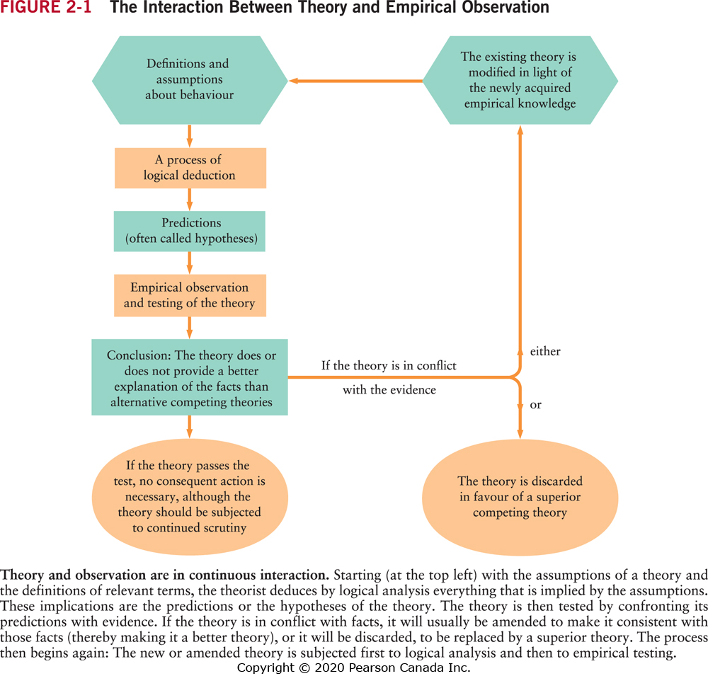
The Interaction Between and Empirical Observation Figure 2-1

Slide 8
Testing Theories (2 of 2)
A theory is tested by confronting its predictions with empirical evidence.
When a theory consistently fails to predict better than an available alternative, it is either modified or replaced.

Slide 9
Statistical Analysis
Used to test a hypothesis such as “if X increases, then Y will also increase.”
Economists must use millions of “uncontrolled” experiments going on every day in the marketplace.
The variables that interest economists are generally influenced by many forces that vary simultaneously.
The analysis of such data requires the use of appropriate—and complex—statistical techniques.

Slide 10
Correlation versus Causation
Positive correlation means only that X and Y move together, in the same direction.
Negative correlation means that X and Y move in opposite directions.
A finding that X and Y are correlated is not direct evidence of a causal relationship.
Most economic predictions involve causality. Establishing causality usually requires advanced statistical techniques.

Slide 11
2.3 Economic Data
Index Numbers
An index number is a measure of some variable, conventionally expressed relative to a base period, which is assigned the value 100.
More Complex Index Numbers: CPI (Chapter 19)

Slide 12
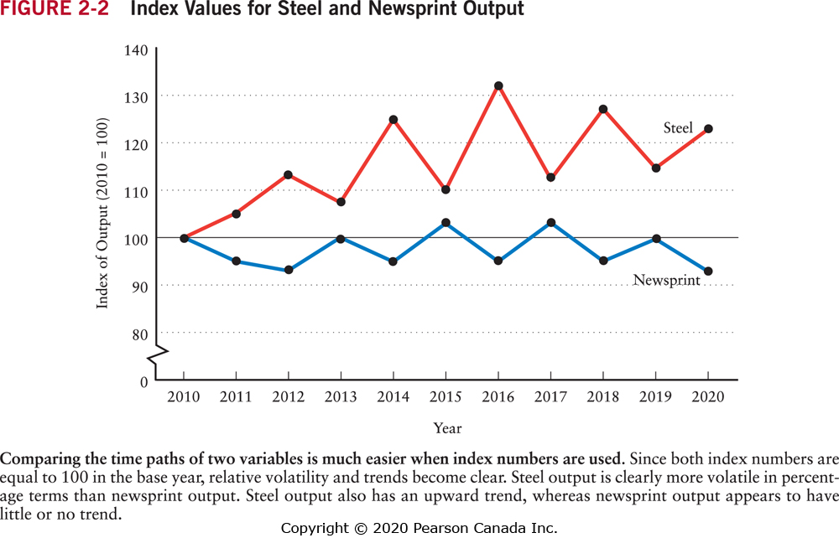
Index Values for Steel and Newsprint Output Figure 2-2

Slide 13
Graphing Economic Data
A single economic variable, such as unemployment, national income, or the average price of a house, can come in two basic forms:
Cross-sectional data
Time-series data
Another way to represent data is with a scatter diagram.
A graph showing two variables, one measured on each axis.
Each point represents the values of the variables for a particular unit of observation.

Slide 14
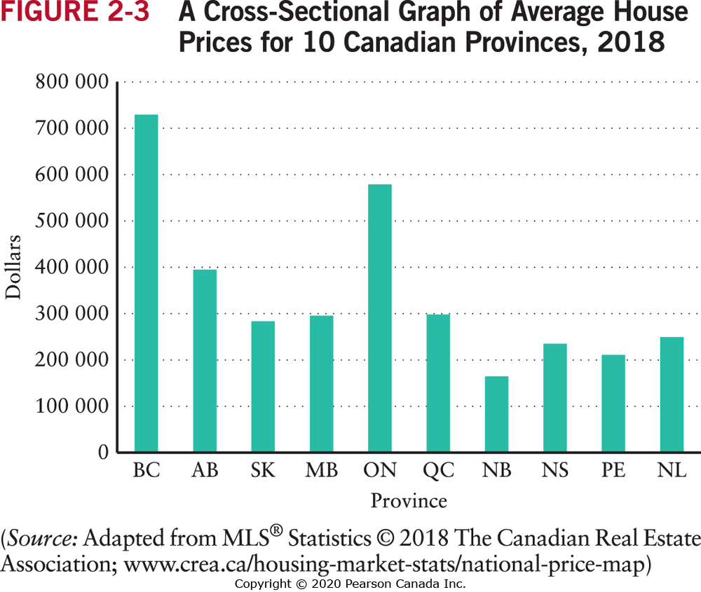
Index Values for Steel and Newsprint Output Figure 2-3

Slide 15
2.4 Graphing Economic Theories
When one variable, X, is related to another variable, Y, in such a way that to every value of X there is only one possible value of Y, we say that Y is a function of X.
Example: When W (wage income) is zero, consumption is $800 a year. For every extra $1 of wage income the person will increase consumption by 0.8($1) or 80 cents.
C= $800 + 0.8W
A function can be expressed:
in a verbal statement
in a numerical schedule (a table)
in a mathematical equation
in a graph

Slide 16
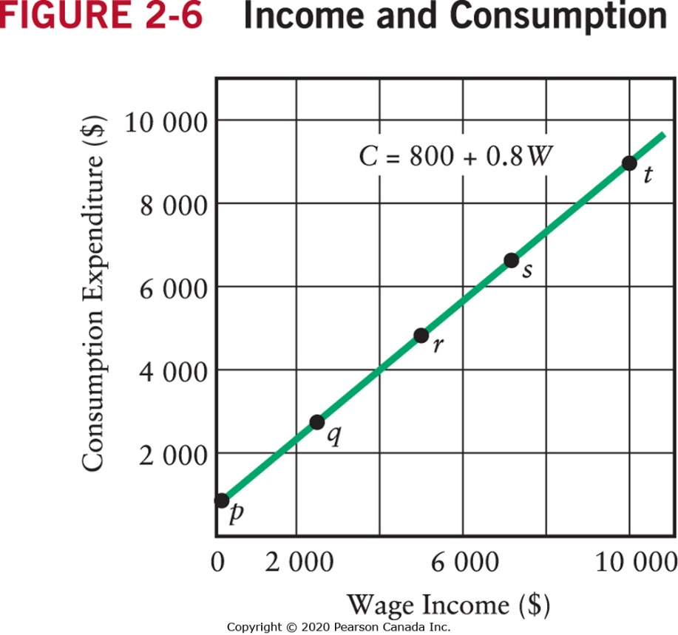
Income and Consumption Figure 2-6
Wage Income (w) | Consumption (C) | Reference Letter
$0 | $800 | p
2 500 | 2 800 | q
5 000 | 4 800 | r
7 500 | 6 800 | s
10 000 | 8 800 | t

Slide 17
Graphing Functions
When two variables move together, the variables are positively related.
When two variables move in opposite directions, the variables are negatively related.
If the graphs of these relationships are straight lines, the variables are linearly related to each other.
A function that is not graphed as a straight line is a non-linear function.

Slide 18
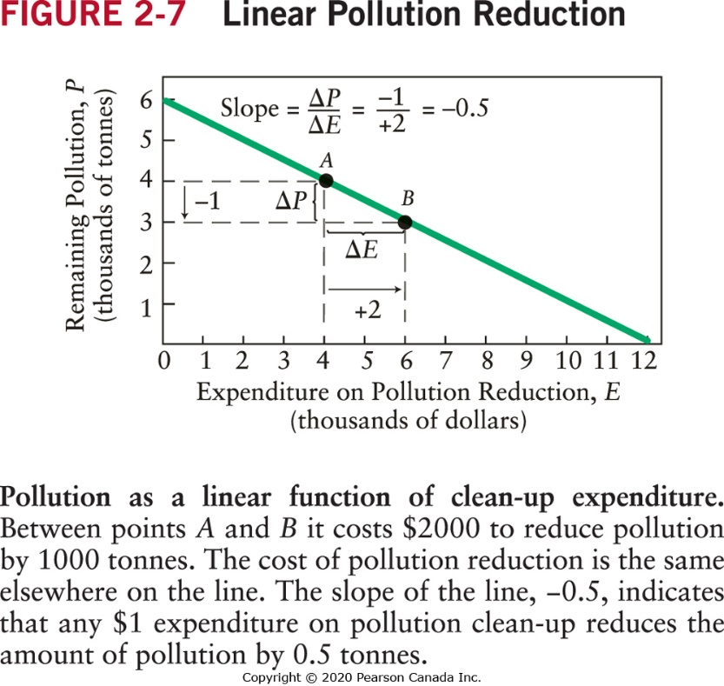
The Slope of a Straight Line
Let X be the variable measured on the horizontal axis and Y be the variable measured on the vertical axis.
The slope of a straight line is calculated as Δ Y/ Δ X.

Slide 19
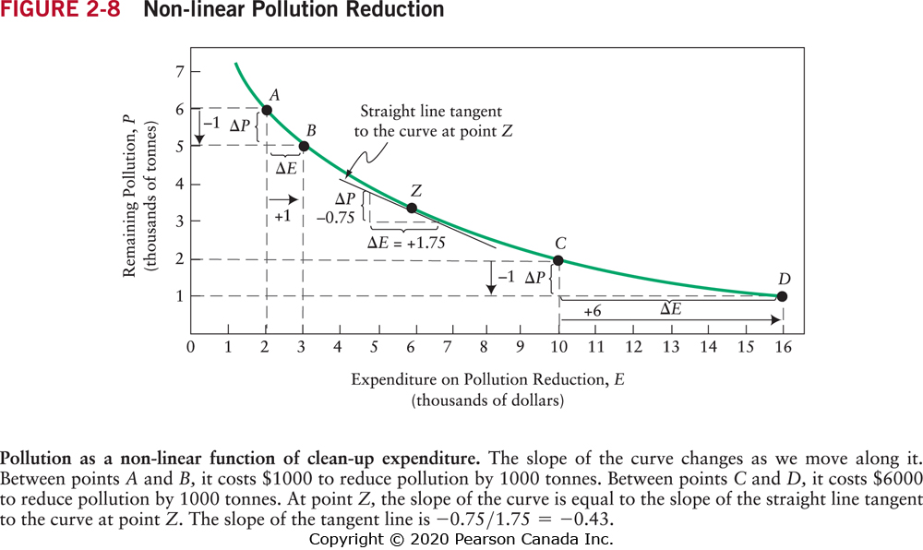
Non-Linear Functions (1 of 2)
This figure illustrates diminishing marginal response.
For non-linear functions, the slope of the curve changes as X changes. Therefore, the marginal response of Y to a change in X depends on the value of X.

Slide 20
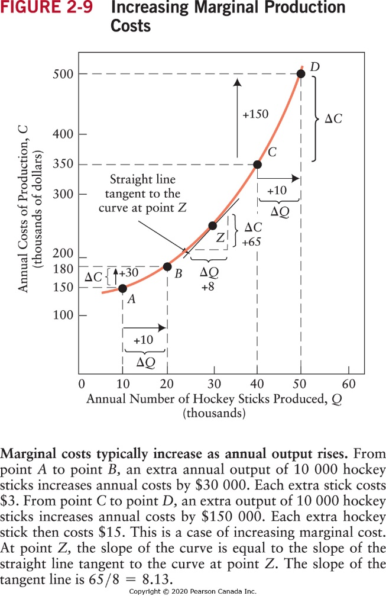
Non-Linear Functions (2 of 2)
This figure illustrates increasing marginal cost

Slide 21
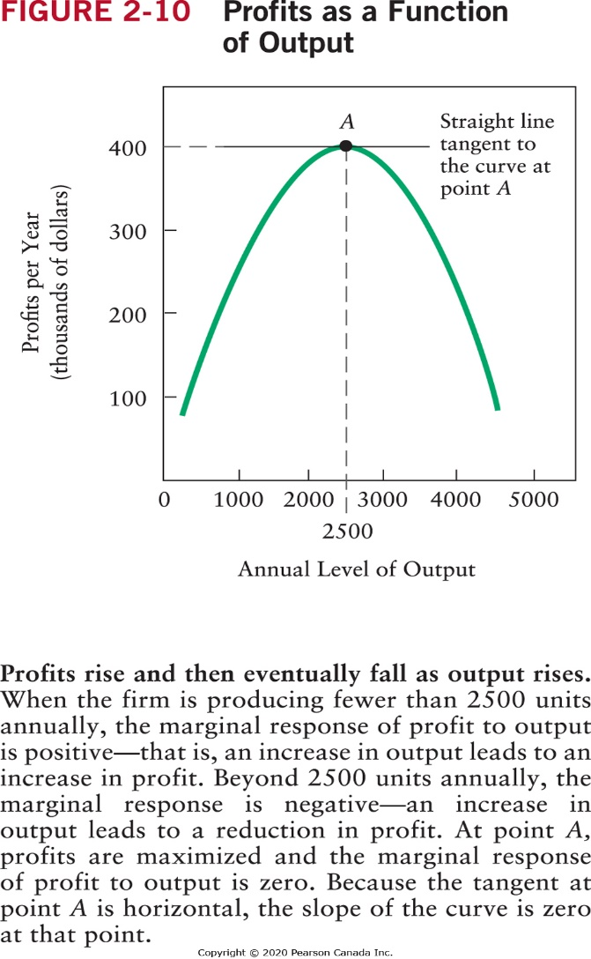
Functions with a Minimum or Maximum (1 of 2)

Slide 22
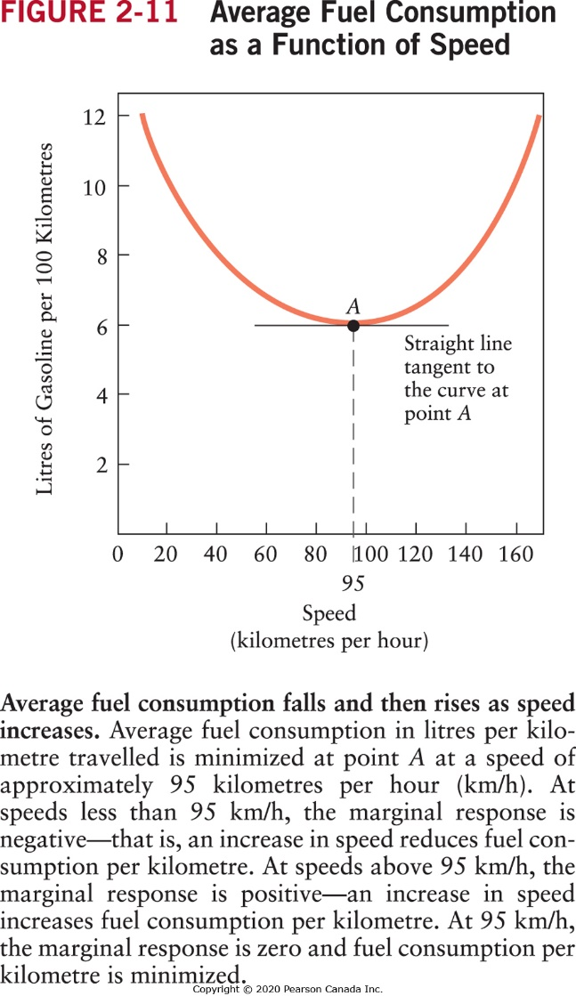
Functions with a Minimum or Maximum (2 of 2)

Slide 23
A Final Word
We have discussed why economists develop theories (or models) to help them understand economic events in the real world.
We have discussed how they test their theories and how there is a continual back-and-forth process between empirical testing of predictions and refining the theory.
Finally, we have explored the many ways data can be displayed in graphs and how economists use graphs to illustrate their theories.

